Slide 1
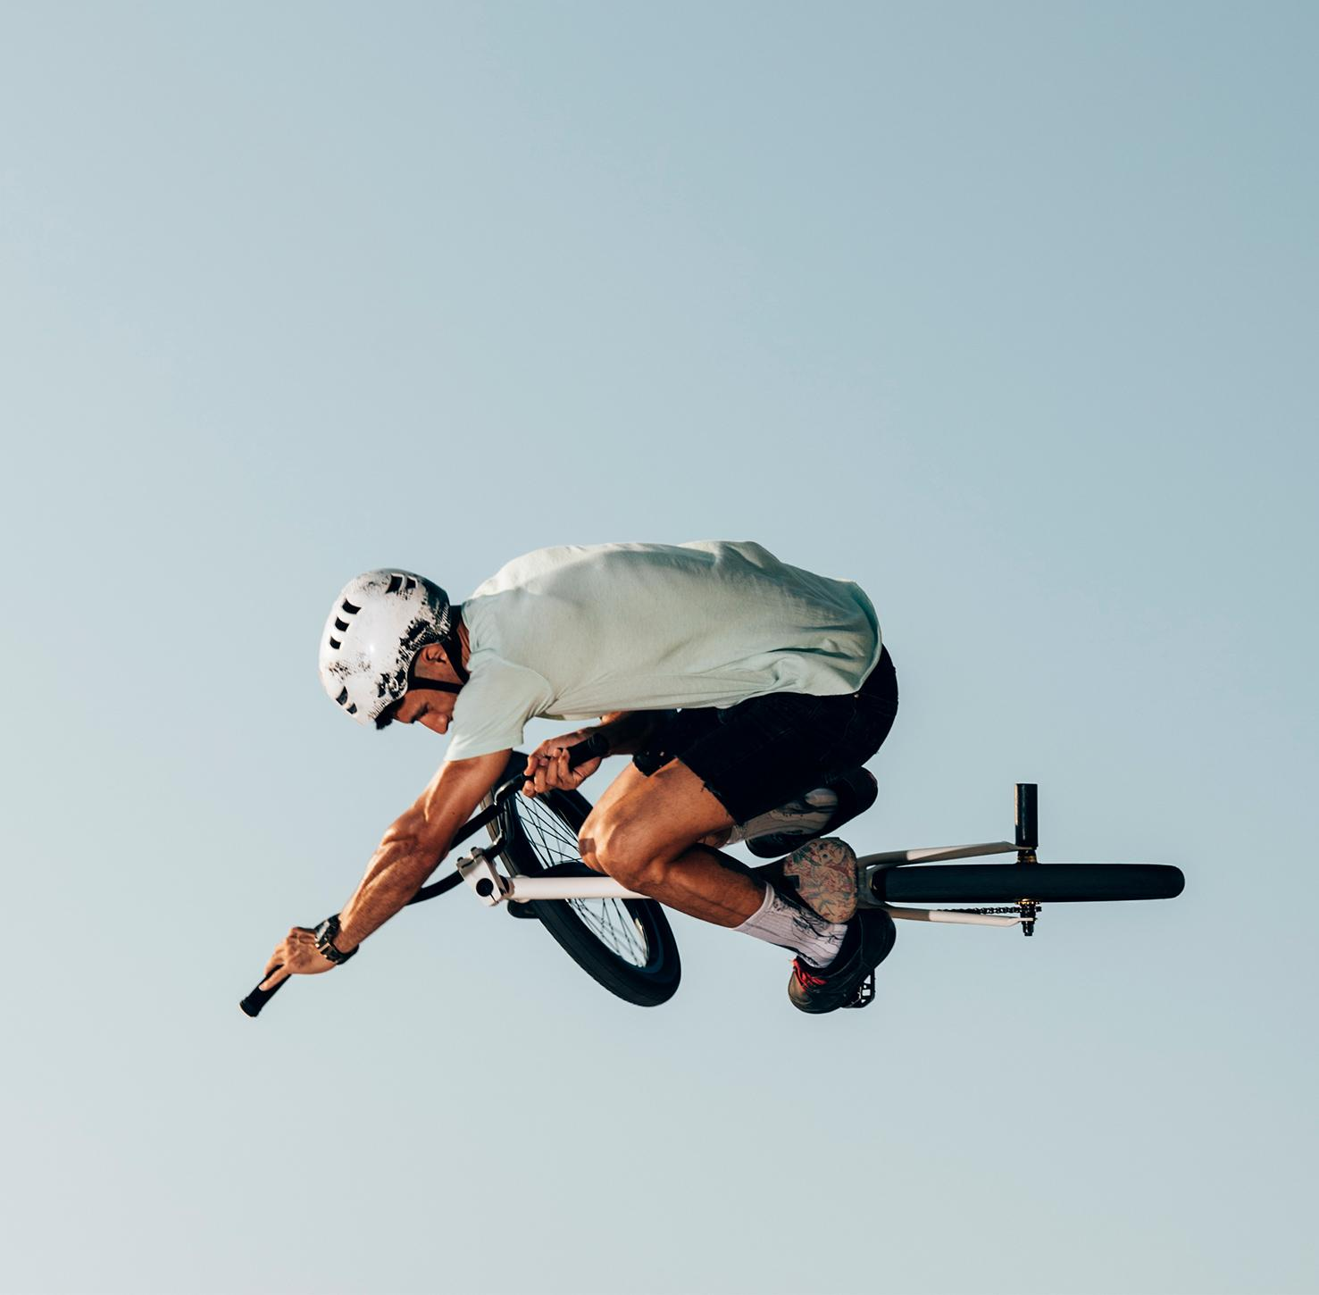
Outdoors Retail
Redefine Coupones
Olga Fishkina, Idan Sabagi, Naomi Levy

Slide 2

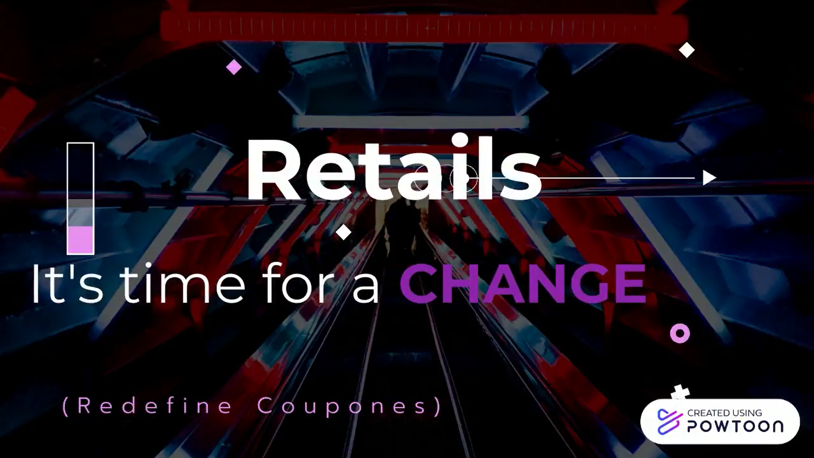
https://www.youtube.com/watch?v=52ad9VM5eOQ

Slide 3
OUR CREATIVE PROCESS
01
02
03
04
05
Discovery
Data Preparation
Building The Model
Model analysis
Conclusion

Slide 4
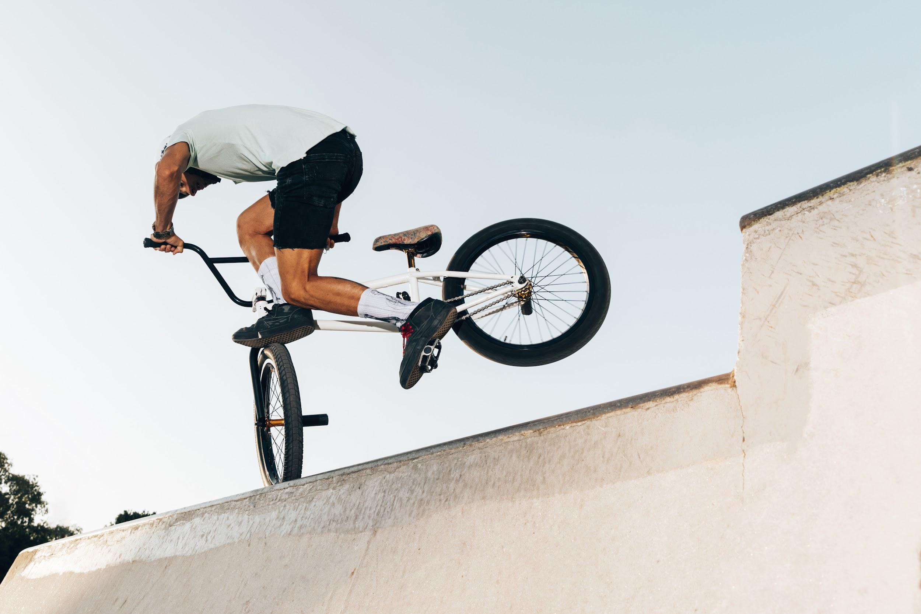
Our objectives
01
02
Recommendation system
Can we predict what similar customers will buy?
Personalized advertising
Can we think of suitable marketing strategies ?

Slide 5
Discovery Our Data
01
Sales Analysis using Real Data, collected for 3-4 year, between the years 2011-2014.
Raw data from our chain store

Slide 6
Data Preparation
02
Remove of nulls
Translation of city names
Separating of customer number from transaction code
removing empty and nan information columns

Slide 7
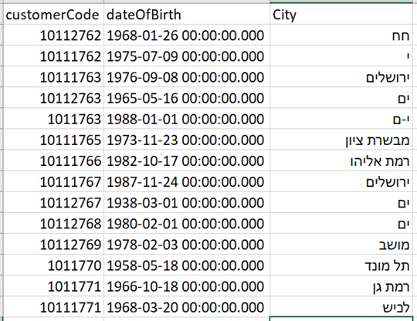
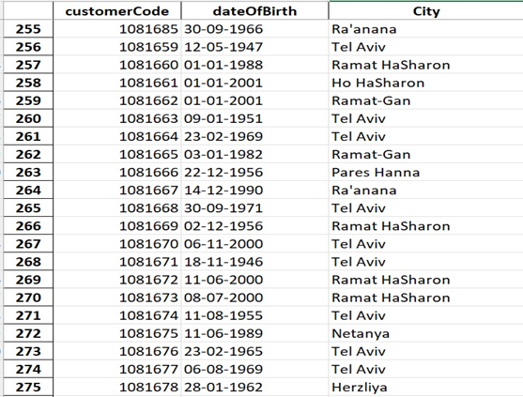
Our tables
Before
After

Slide 8
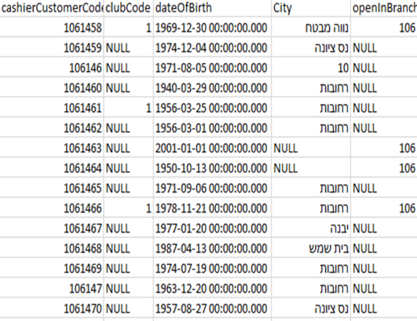
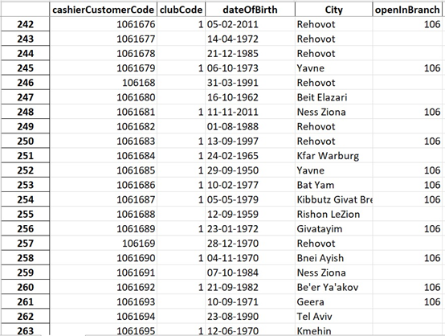
Our tables
Before
After

Slide 9
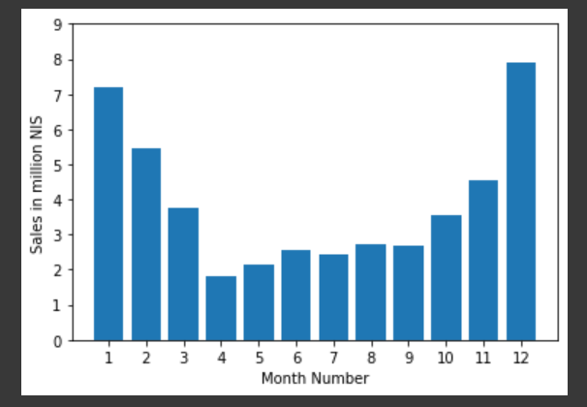
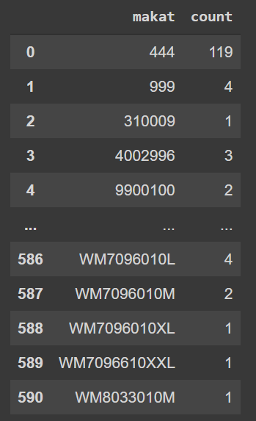
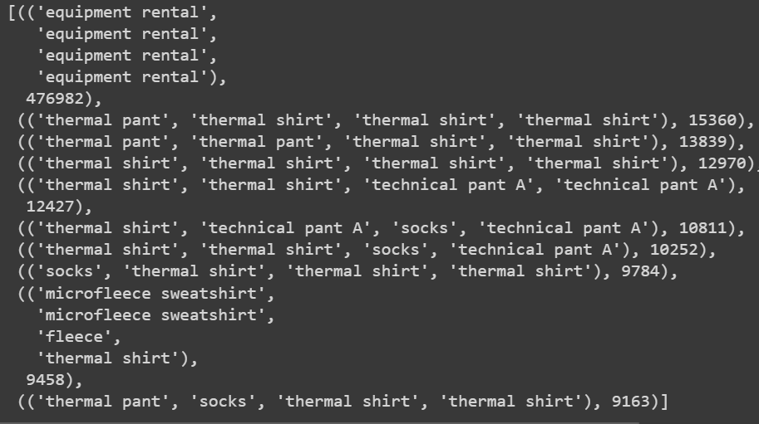
Understanding the data
Products bundles
What was profit each month
How much products were sails with each barcode?

Slide 10
Building the model
03
Clustering algorithm
Collaborative filtering
Knn using k means
PCA

Slide 11
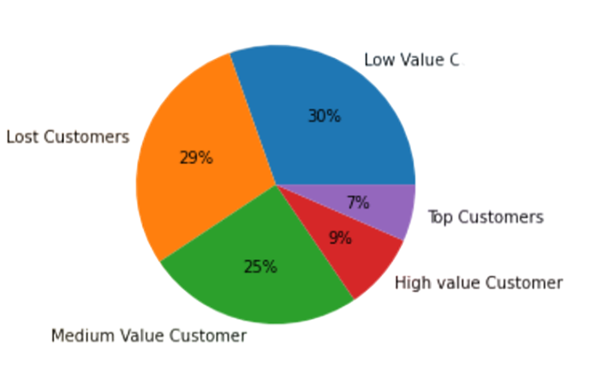
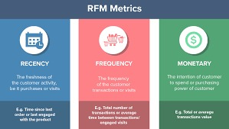
Clustering algorithm
RFM score

Slide 12
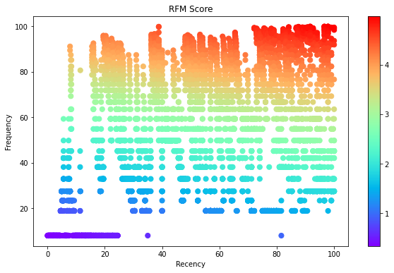
Clustering algorithm
RFM score

Slide 13
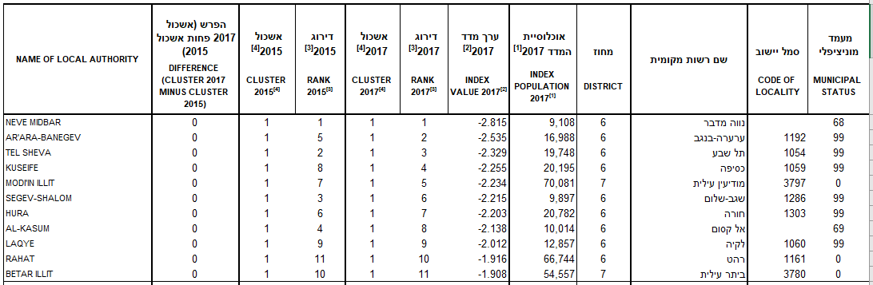
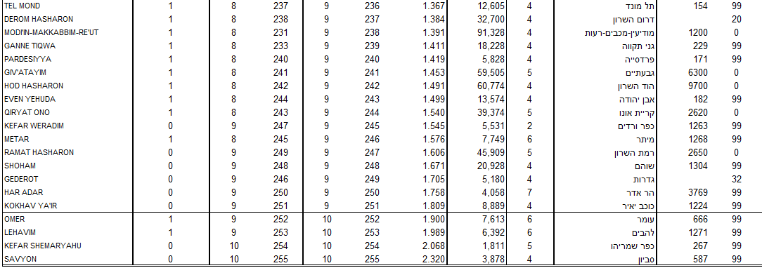
Extrnal Data

Slide 14
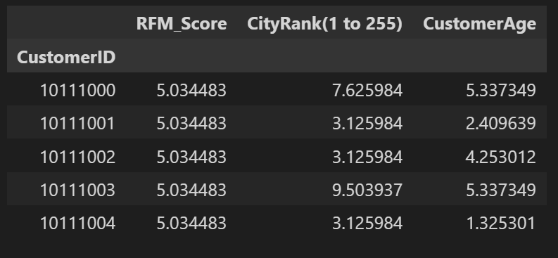
Clustering algorithm
Features

Slide 15
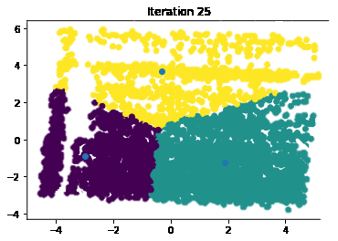
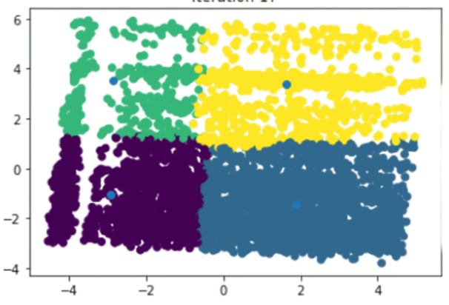
Clustering algorithm
SIMILAR CUSTOMERS CLUSTERS

Slide 16
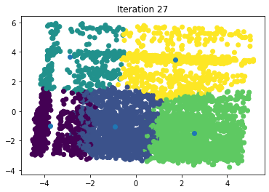
Clustering algorithm

Slide 17
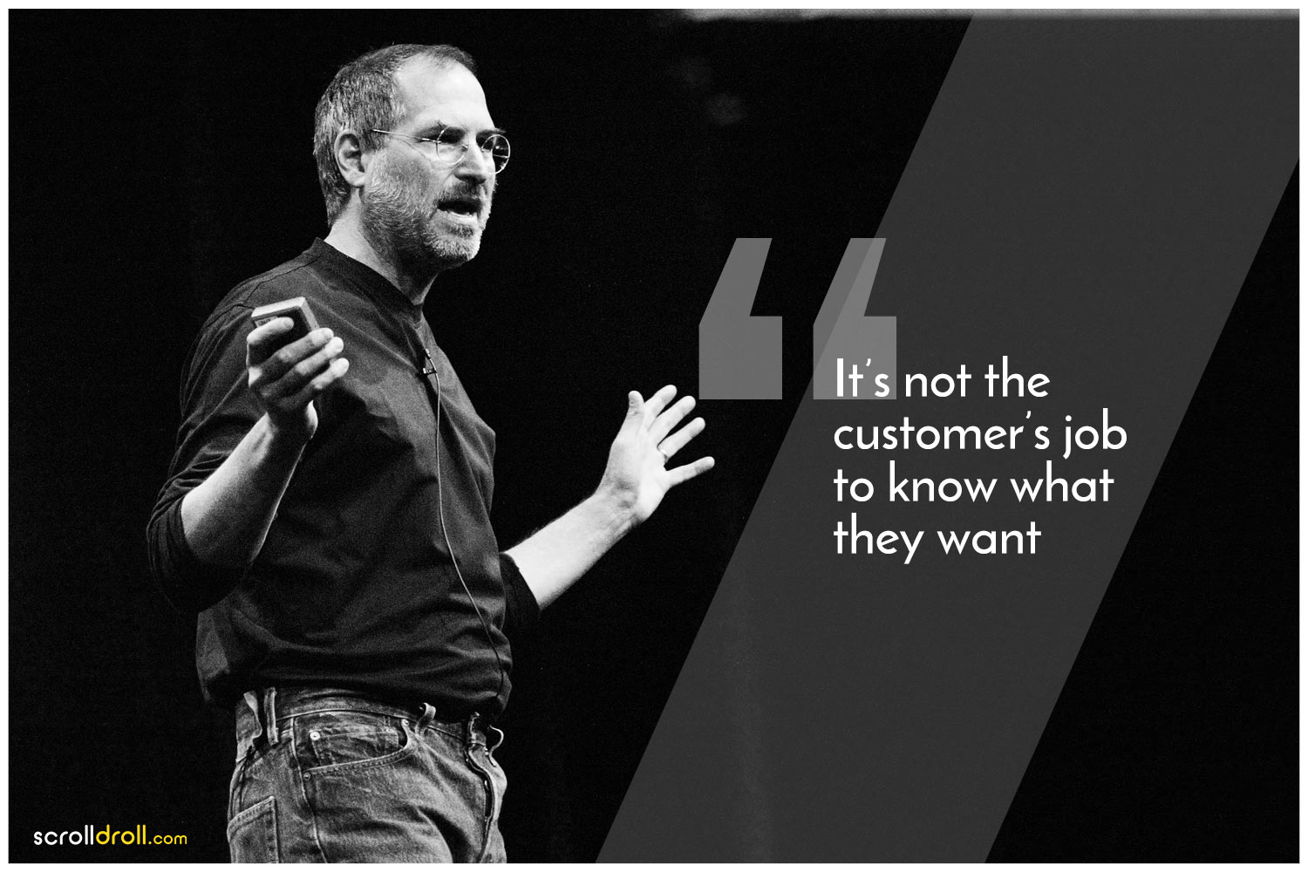

Slide 18
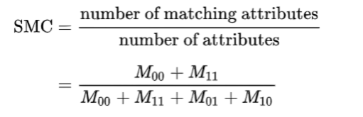
Collaborative filtering
Using Simple matching coefficient
*unlike the Jaccard index, the SMC was more suitable since
it addressed mutual presences and absence in both sets

Slide 19
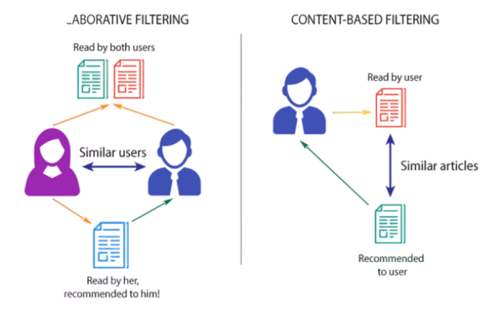
Collaborative filtering

Slide 20
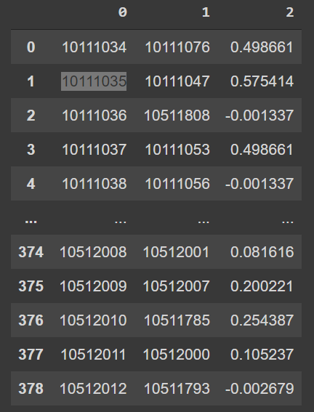
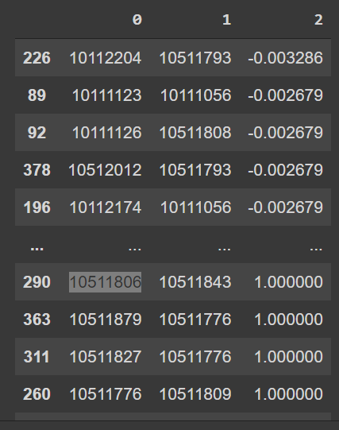
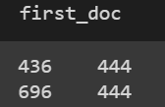
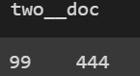
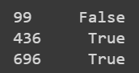
User Collaborative Filtering
Simple matching coefficient between similar customers

Slide 21
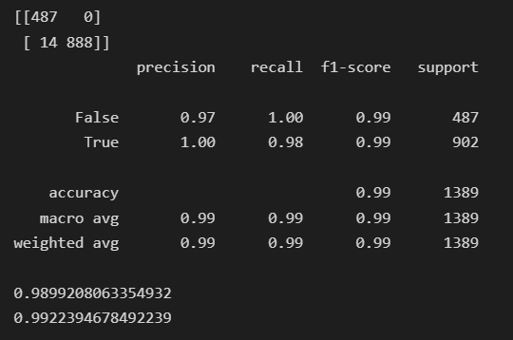
04
Model analysis
Clustering model

Slide 22
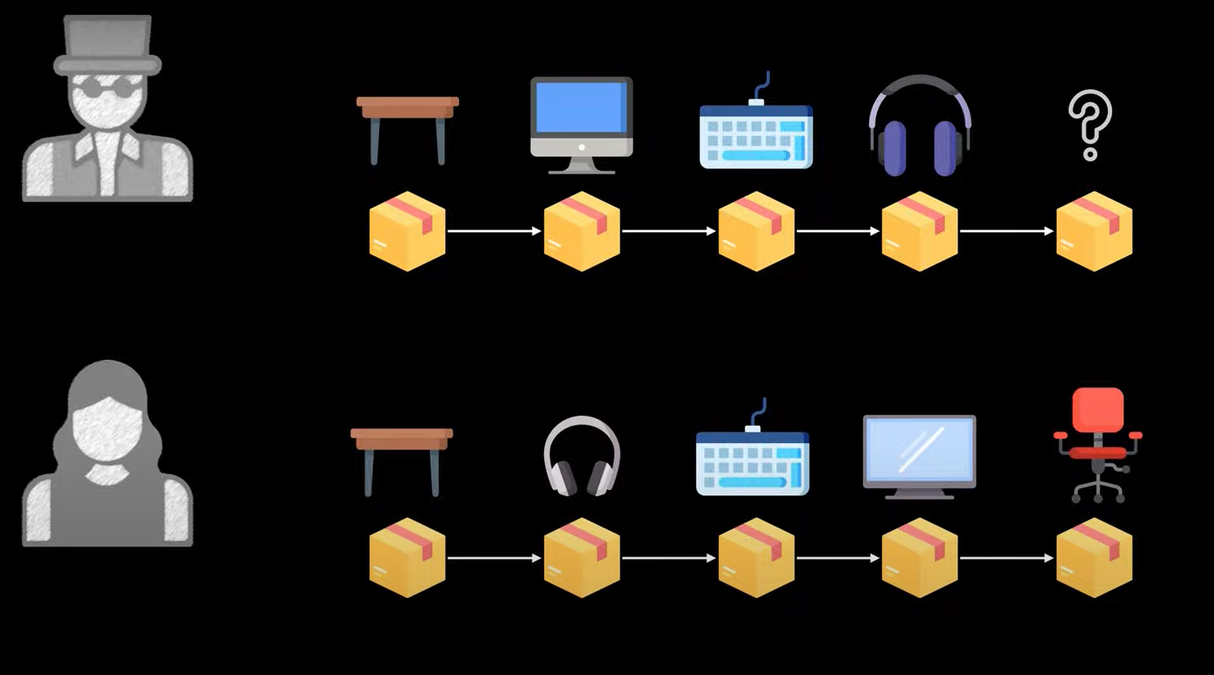
The Theory

Slide 23
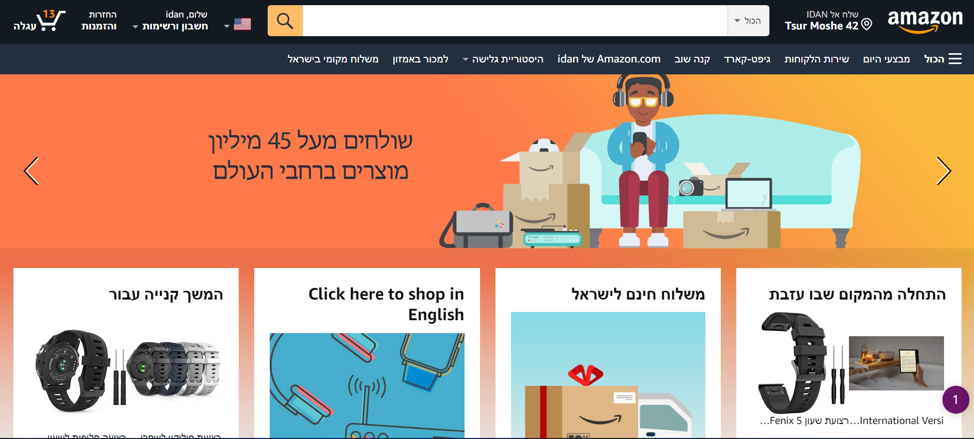
The Rael life

Slide 24
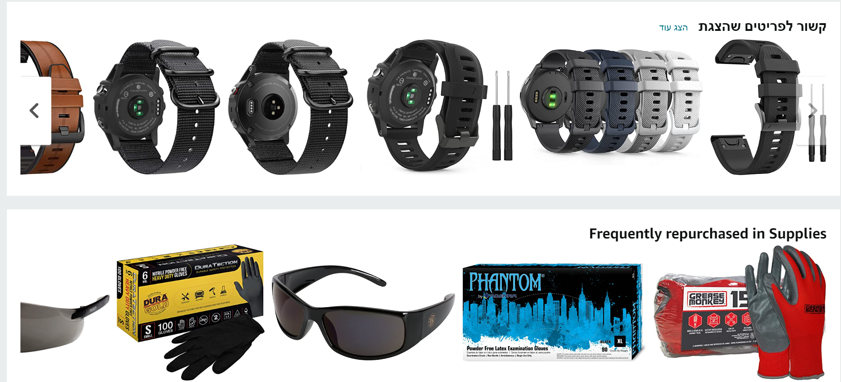
The Rael life

Slide 25
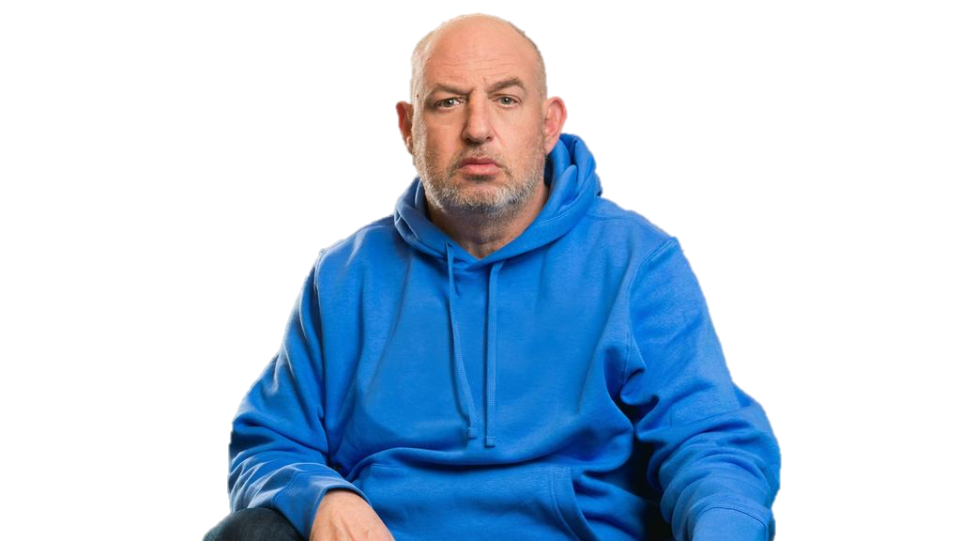
Let Try Together

Slide 26
Thank You

